Slide 1
COMP 201 OPEN SOURCE & SYSTEM ADMINISTRATION
DANIEL OBUOBI, DCSIT, CU
Free BSD Installation

Slide 2
FreeBSD Installation
AFNOG CHIX, Accra Ghana
OCTOBER 2008

Slide 3
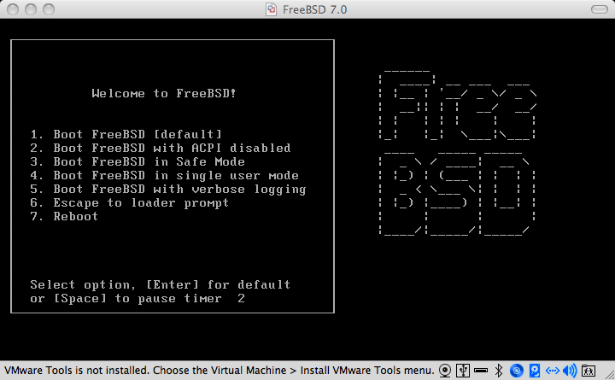
Boot Off CD
Insert the FreeBSD 7.0 CD1 on your machines into your CD-ROM drive and (re)boot the machine

Slide 4
KeyMap
You then need to say what country you are in. Choose Ghana from the list (scroll up with the up arrow) so it will allow you to choose what your keymap looks like.
The Keyboard map tells the Operating system what characters are printed on your keyboard. Scroll up and choose english.iso ( the screenshot is in the next slide).

Slide 5
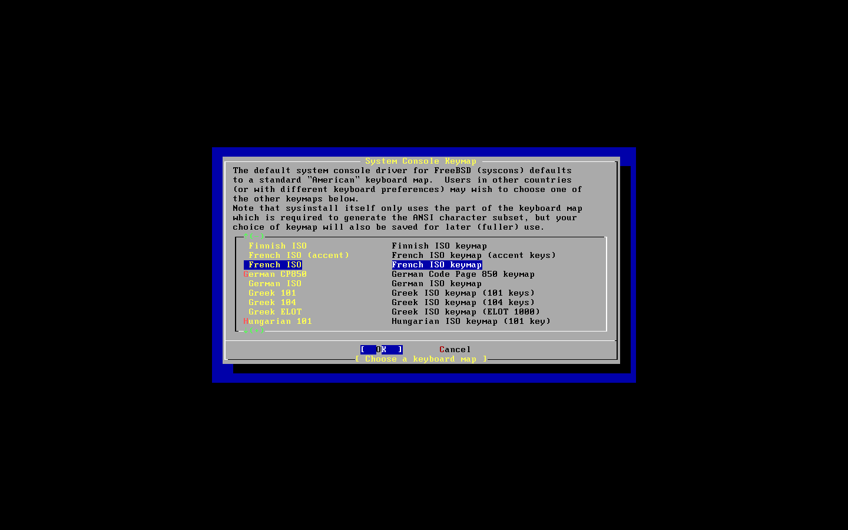

Slide 6
Sysinstall
Finally you’ll get to the sysinstall menu. Sysinstall is the installer tool used to get FreeBSD onto your machine – and optionally configure it later.
Move through it by using your up and down arrow keys, use the space or enter key to choose the highlighted option.
If there are “buttons” at the bottom of the screen, you can navigate to it by using the tab key then using the enter key.
Select a standard installation and the next thing we need to do is partition our disk.

Slide 7
Disk Partitioning/installation
In your case, you are presented with a choice of disks to partition. We will use just the first 80GB disk.
Select it with the space button so we can start slicing the disk.
In our case we are going to use the entire disk so use “a” to tell FreeBSD to use as much of the disk as it can.
If you plan to use multiple operating disks you need to create different slices for the other operating systems.
When done with the slicing, then use “q” to quit the fdisk partition editor

Slide 8
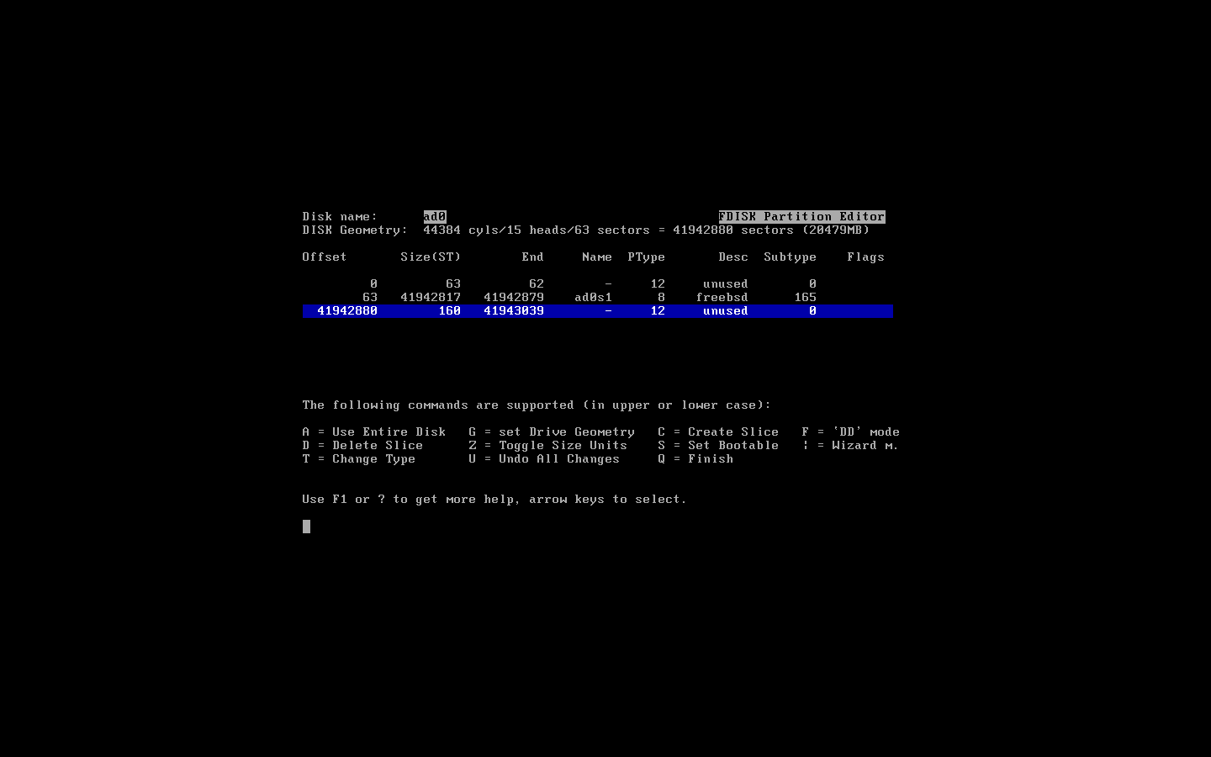
Slicing

Slide 9
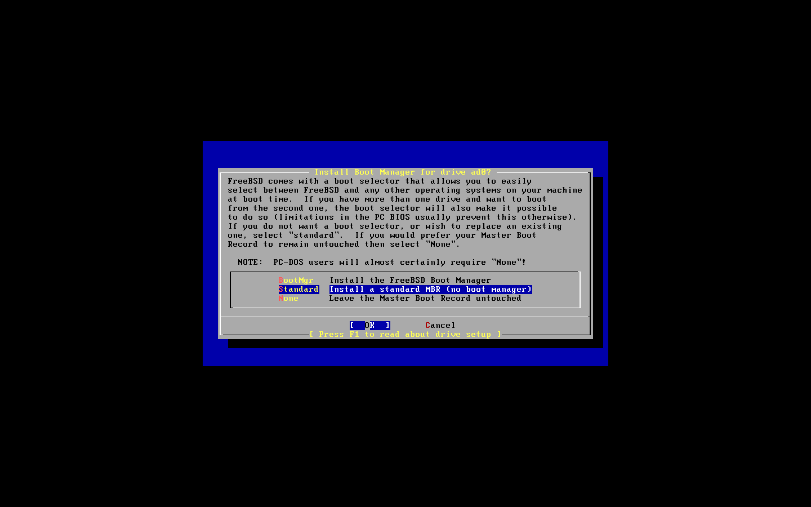
Boot Blocks
Next you decide what FreeBSD will put in your MBR. If you have multiple operating systems you want a boot manager. In our case, standard MBR will do. (none is for if you have GRUB or something else)

Slide 10
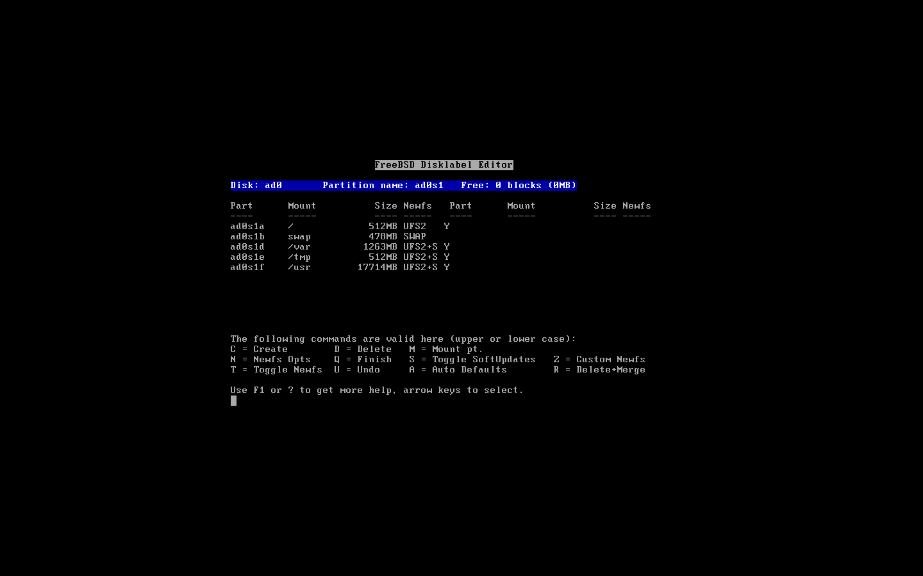
Partitions
Fdisk is launched again to create partitions inside the slice you created. Use “a” to automatically create partitions, watch the screen for a demo on how you’d do it yourself.

Slide 11
Multiple Disks
On computers with more than one disk you are returned to the menu where you choose which disk you want to slice and partition.
If you plan to you use both disks you can put some partitions on the second disk (like /usr or /var or /data) by going selecting the second disk and slicinging it and using fdisk to put partitions in there as was demoed on the screen.
In our case we use tab to go to ok and continue with the installation. We’ll leave the second disk blank in case we get the chance to do actual mirrors later in the week.

Slide 12
Choice of packages
Next we get to chose which packages we want installed. You can either choose predefined package groups or make your own selection. For our case we’ll choose a small distribution and add packages we need during the week.
In this window use the arrow keys to move to a distribution, use the space bar to select the distribution.
Our distribution is going to be X-User so scroll down and select it with the space bar.

Slide 13
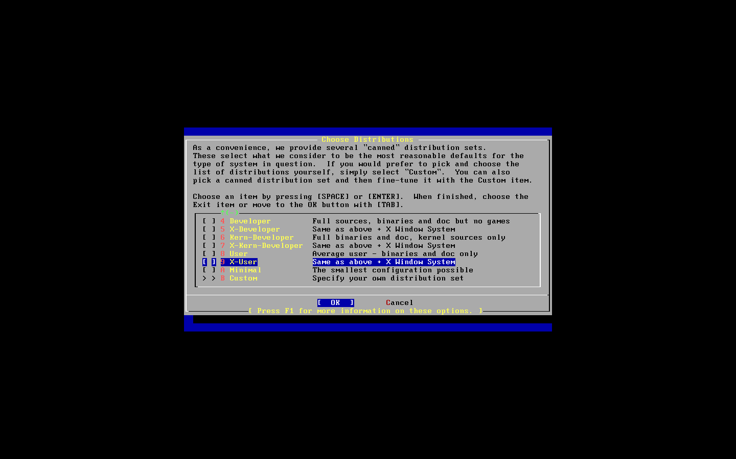
FreeBSD Distribution

Slide 14
Ports
You will be asked if you want to install the ports system. Hit the “Enter” key to say “yes” we will discuss how to use the ports system in the next session.
Once that is done you need to exit the distribution selection. Use the tab key to select “OK” and move on to the media selection.
FreeBSD can install these packages from all kinds of media – CDROM, FTP, HTTP, NFS mounts, even a huge stack of floppies.
In our case we’ll use the CDROM for now, FTP will be used in the next session.

Slide 15
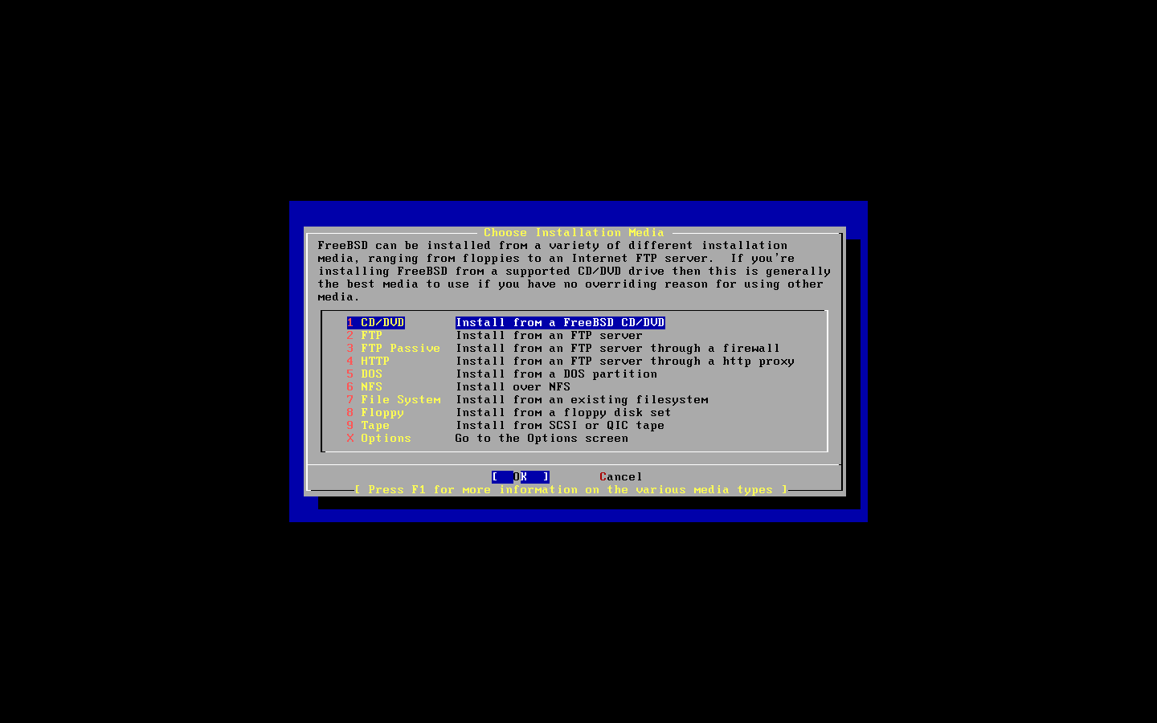
Media Selection

Slide 16
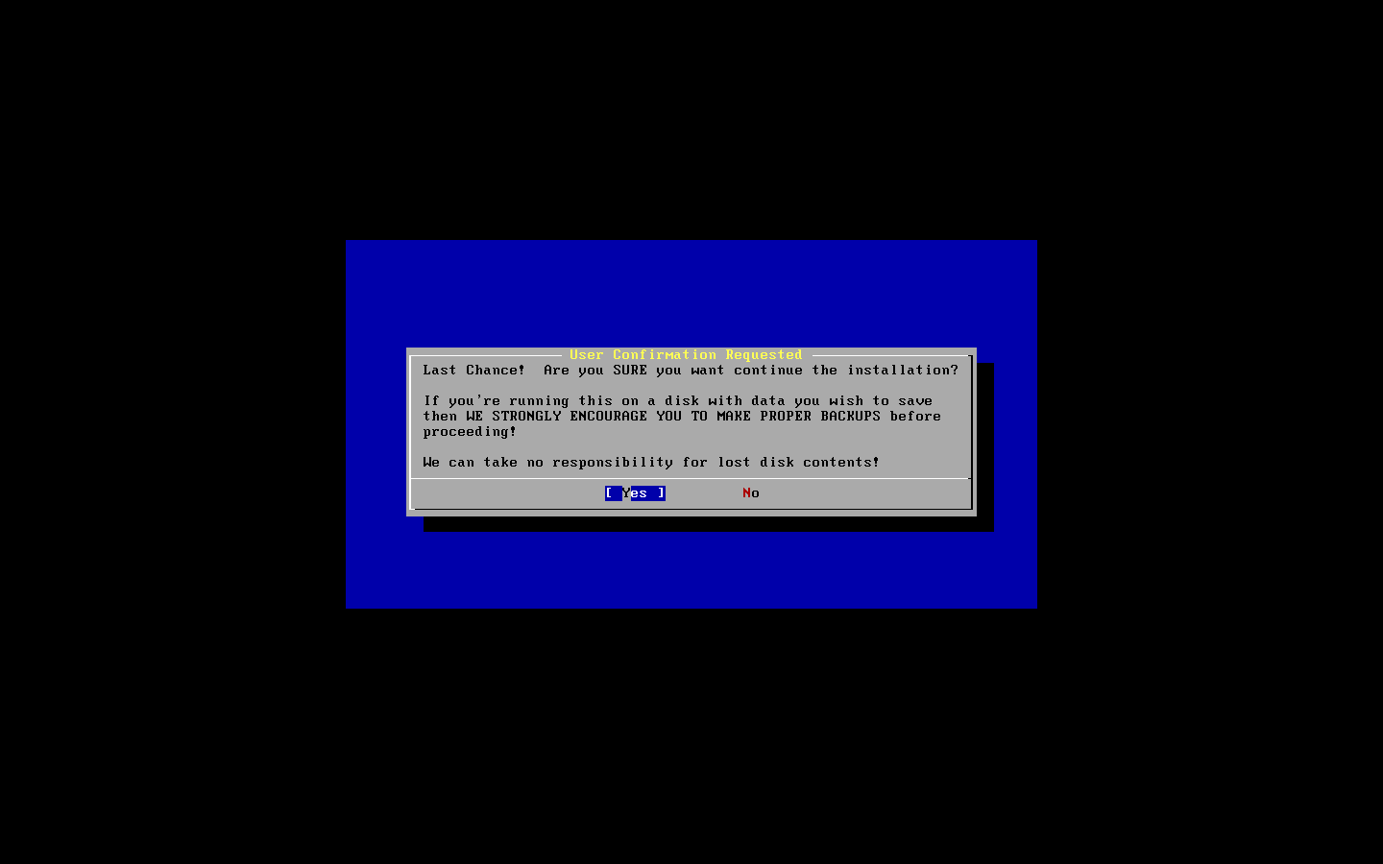
Point of no return
You are now presented with an important prompt. Prior to this, no actual data has been written to disk. If you chose no, you can have your system unmodified. If you chose yes, then every thing from the partitioning starts to happen. Chose yes and watch.

Slide 17
Post Installation Tasks
At this point, the FreeBSD operating system has been installed on your computer. We shall now do some post installation tasks to get some attributes of your system working.
Say “Yes” to configuring your ethernet device. You are presented with a menu, select the first one which should be em0 – your ethernet card.
You will be asked if you want to try IPv6 configuration for your card, say “yes”
You will be asked if you want to try DHCP configuration for your card, say “no”
Next is the IPv4 configuration which you should set similar to this. Substitute the IPv4 address and hostname fields as relevant.
Leave the gateway, domain, and name server fields constant.

Slide 18
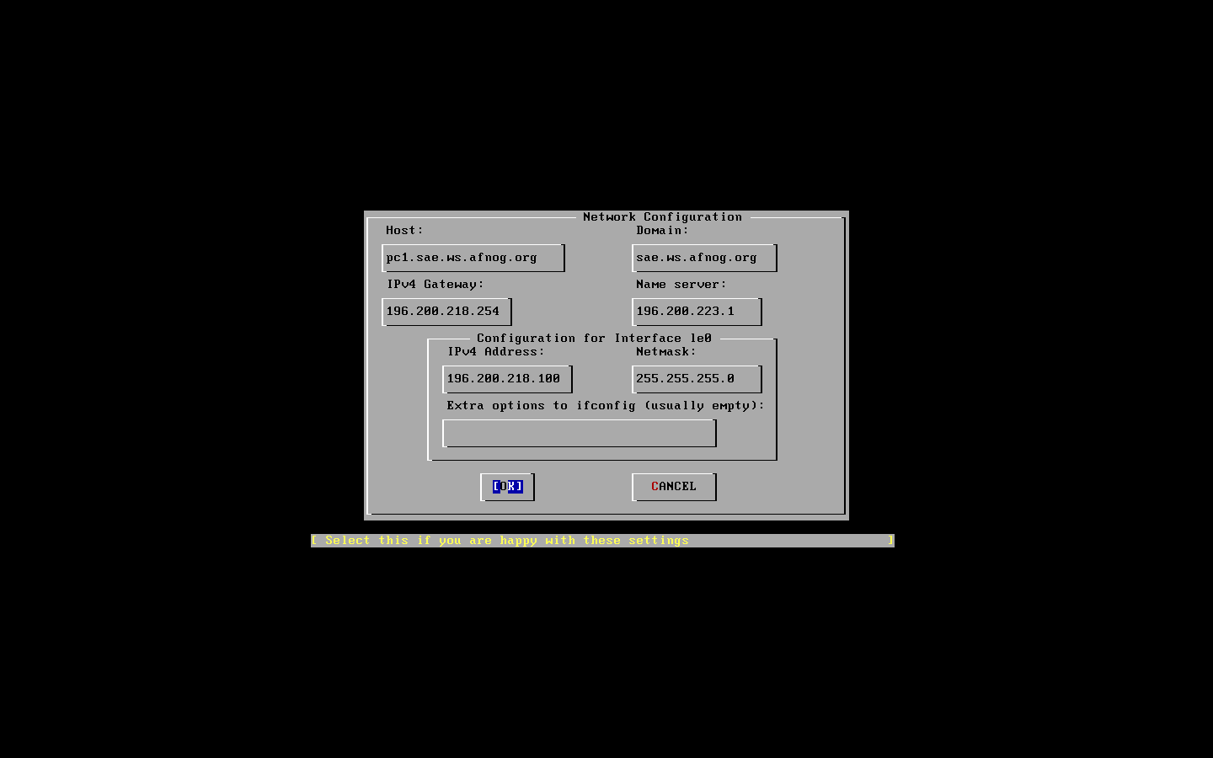
IPv4 configuration

Slide 19
IPV4 Configuration
ipv4 gateway= 41.204.44.254
ipv4 address= 41.204.44.x here x=101,102,etc
Netmask =255.255.255.0
Name server =63.216.0.5

Slide 20
Startup Options
You are then presented with options to start different services on boot.
Say “NO” to all of them except ssh.
You will also be asked if your clock is set to UTC – say “yes”.
You then need to set the timezone on your machine, say yes to that, select “Africa” then select “Ghana” and you should end up with a prompt like the one which follows. – say “yes” to the prompt.

Slide 21
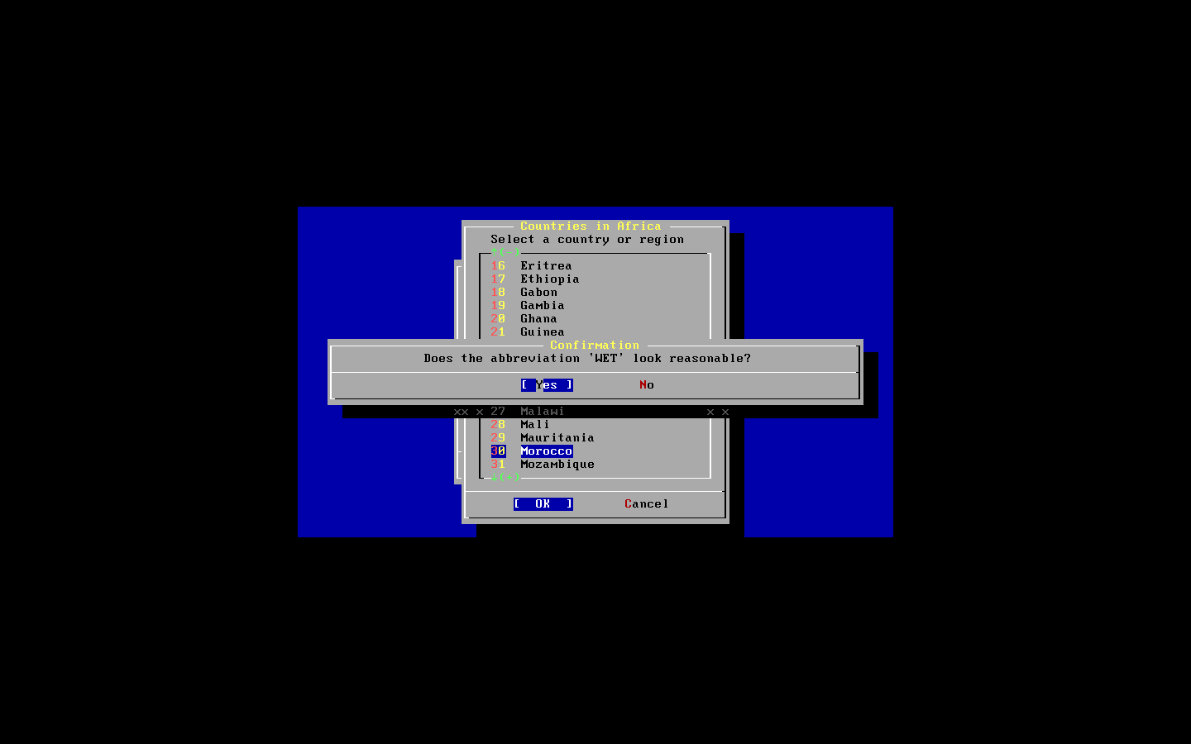
Timezone

Slide 22
Additional Steps
Say “Yes” to enable linux binary compatibility (this allows your FreeBSD to run linux applications natively)
Say “yes” to whether you have a mouse connected.
The default settings (autoprobe) work fine, just go down to enable and select that.
When done go to exit to leave this menu.
Answer “NO” to browsing the package selection
Do not add a user account at this point, one of the exercises that follows does this.
Set your root password to afnogchix08 . Please leave this password as is so instructors can fix your machines if the need arises..

Slide 23
First Boot
Next you’ll be asked if you want to visit the configuration menu for the last time, say no.
Press the x key to exit systinstall press enter, and remove your disk from the drive as the machine reboots.
Log in with the username root ; password afnogchix08 (use the numeric keypad) and type the following commands. Include all the quotation marks and don’t forget the double “>>” not a single “>” replace 100 with the last part of your real IP address. The ‘#’ just means you type the commands as root.
# echo ‘ipv6_ifconfig_em0=“2001:4438:0:218:196:200:218:100”’ >> /etc/rc.conf
# /etc/netstart

Slide 24
FreeBSD ports & packages

Slide 25
FreeBSD ports & packages - overview
Different UNIX distributions use different package systems for distributing software
Debian GNU/Linux and Ubuntu use .DEB
SuSE, RedHat, Fedora use .RPM
etc..
FreeBSD uses a simple format (.TGZ)‏
Where do they come from ?

Slide 26
Installing software on FreeBSD
Normally 3 ways to install software on FreeBSD:
from the « source » # ./configure; make; make install
from the port
from the package

Slide 27
The FreeBSD ports collection
Described in detail at
http://www.freebsd.org/doc/en_US.ISO8859-1/books/handbook/ports.html
The ports is a collection of « skeleton » instructions (Makefile, patches) to retrieve, configure, build and install software
The ports collection contains instructions for over 16.000 software programs as of 2007, and it is still growing.

Slide 28
Installing software ...
Open source software is shipped in source form; to be usable on a system
1. It must be unpacked
2. It must be adapted to the system one is running on (« porting »)‏
3. It may be compiled (source -> binary)‏
4. It must installed
5. It may need to be configured

Slide 29
Installing software ...
The ports system takes care of steps 1 – 4, and sometimes 5
(preconfiguration)‏
The build and installation process might trigger the build and
Installation of other required software
– this is known as « dependencies ».
For example, a graphics program might need
a JPEG software library to be able to read and write JPEG images

Slide 30
From port to package
Once the port is built, one can make a package
A package is a pre-built port
Packages can be installed...
from the network via FTP
from the FreeBSD CDROM
Packages can be those built by the FreeBSD project or your own

Slide 31
Ports vs packages
PACKAGES
precompiled
easy to install
no need to have ports collection installed
PORTS
more and better configuration
control / options
(for example Apache and PHP)‏
local patches possible
tuning options

Slide 32
Installing packages
pkg_add [-r] <package name>
For instance: # pkg_add -r bash
This will attempt to install the bash package from the network
Problems:
what if bash depends on other software ?
which version of bash ? 2 or 3 ?
pkg_add will try to install dependencies, if they are available

Slide 33
Installing packages
If you have the package on CD, and the CD is mounted, you can install it directly, for instance: # pkg_add /cdrom/packages/All/bash-3.1.10_1.tbz
If you know the URL (Link) to the package on the Internet, you could: # pkg_add ftp://ftp.freebsd.org/pub/FreeBSD/releases/i386/6.1-RELEASE/packages/All/bash-3.1.10_1.tbz

Slide 34
Ports
To install a port, you can search by name or keyword: # cd /usr/ports; make search name=<name> # cd /usr/ports; make search key=<keywrd>
Once you know where the port resides (its category), you can go to that directory, and install it: # cd /usr/ports/shells/bash3 # make # make install # make clean
That's it!

Slide 35
Ports
If you want to build a package, you just need to type: # make package
... from the directory where you built the port from.

Slide 36
Best of both worlds
But what if...
you don't know in which category the port is located or which version you want;
you can't find up-to-date packages for the version of FreeBSD you are running (maybe it's a bit older) ;
you want to upgrade a package, but other packages depend on it ;
For all the above reasons, it is strongly recommended to use a tool called portupgrade

Slide 37
Portupgrade
Portupgrade is a « meta » package manager. It sits on a layer above the ports and package system, and makes your life easier
Portupgrade greatly simplifies package installation, upgrades.

Slide 38
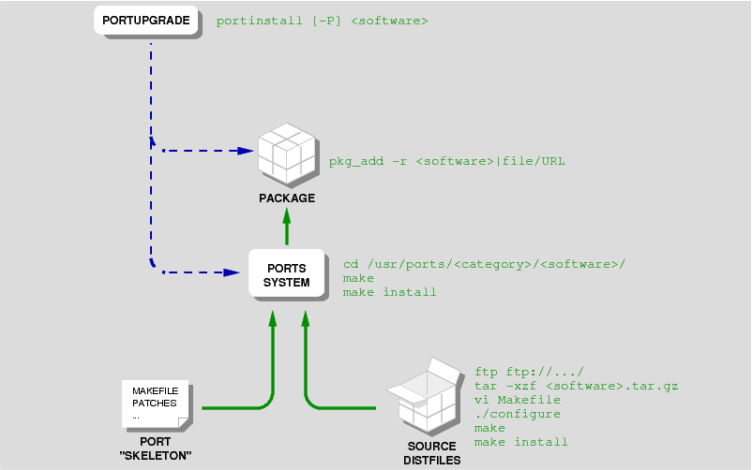
The big picture

Slide 39
Installing portupgrade
Portupgrade is itself a port, and can be installed as such, or as a package:
# cd /usr/ports/sysutils/portupgrade # make # make install # make clean
or # pkg_add -r portupgrade
It can also be installed at system install time (via sysinstall)‏

Slide 40
Using portupgrade
To install a program with portupgrade # portinstall <port name>
For instance: # portinstall bash

Slide 41
Using portupgrade
Portupgrade can be told to try and install a pre-built package, using the -P option, one or more times:
Try and install from a package, fallback to the port if the package isn't found: # portinstall -P <port name>
Try and install from a package, stop if it's not found: # portinstall -P -P <port name>

Slide 42
Using portupgrade
To upgrade an already installed software package: # portupgrade <package name>
For instance: # portupgrade apache

